Slide 1
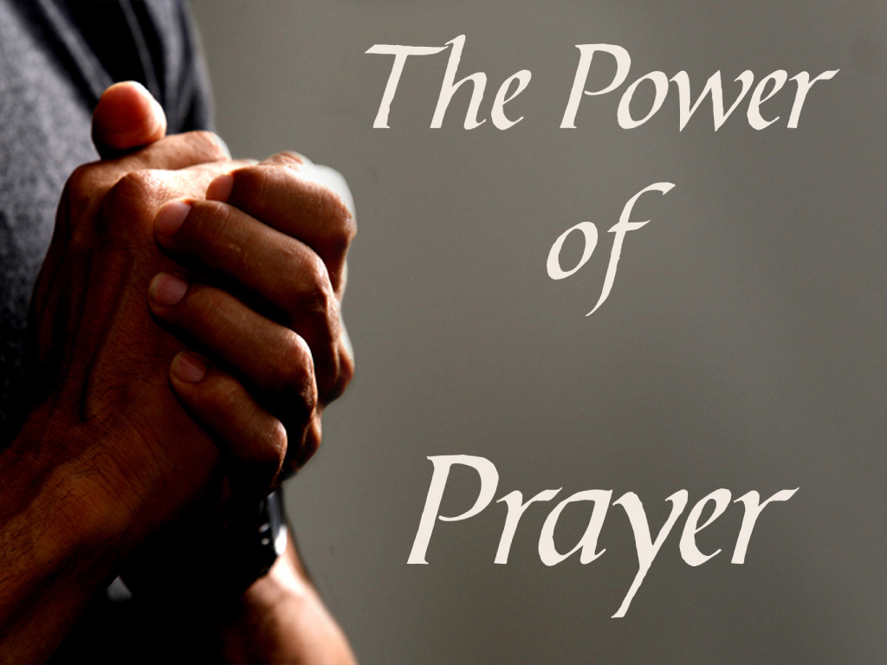
Qualifications for Prayer Spirituality IV

Slide 2
Qualifications for Prayer
Object of Prayer
Trinitarian Formula
Salvation and Sanctification
Personal and Communal

Slide 3
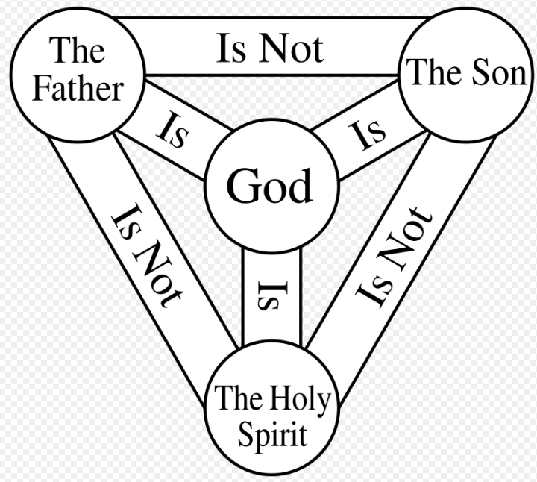
Qualifications for Prayer
Object of Prayer
Trinitarian Formula

Slide 4
Qualifications for Prayer
Trinitarian Formula
The Trinitarian formula is the phrase “in the name of the Father, and of the Son, and of the Holy Spirit” or words to that form and effect, referring to the three persons of the Christian Trinity. It is often followed by an “amen“.

Slide 5
Qualifications for Prayer
Trinitarian Formula
Biblical origin
These words are quoted from a command of the risen Jesus in the Great Commission: “Go, therefore, and make disciples of all nations, baptizing them in the name of the Father, and of the Son, and of the Holy Spirit” (Matthew 28:19); a small minority of other translations read, “into the name”.
Whereas some have argued that Matthew 28:19 was an interpolation on account of its absence from the first few centuries of early Christian quotations, scholars largely accept the passage as authentic due to its supporting manuscript evidence and that it does appear to be quoted in the Didache (7:1-3) or at least reflected in the Didache as part of a common tradition from which both Matthew and the Didache emerged. (https://slife.org/trinitarian-formula/)

Slide 6
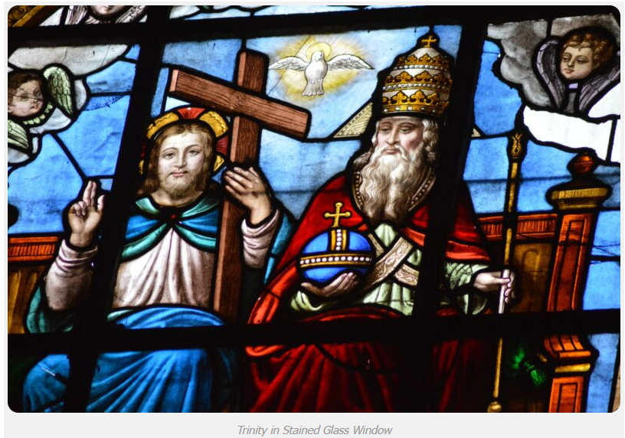
Qualifications for Prayer
Trinitarian Formula

Slide 7
Qualifications for Prayer
Trinitarian Formula
Use in baptism
According to the doctrines of Roman Catholicism, Oriental Orthodoxy, Eastern Orthodoxy, and most forms of Protestantism, such as Lutheranism and Anglicanism, a baptism is not valid if the Trinitarian formula is not used in the administration of that sacrament. Consequently, they may not recognize religious communities that baptize without this formula – e.g. Unitarians, Branhamists, Frankists, Jehovah’s Witnesses, and Oneness Pentecostals, all of whom deny the Trinity – as Christian religions. This is also the case with baptisms within The Church of Jesus Christ of Latter-day Saints (LDS church). (https://slife.org/trinitarian-formula/)

Slide 8
Qualifications for Prayer
Trinitarian Formula
Use in baptism
Although LDS members baptize with the same Trinitarian formula, they reject the Nicene Trinitarian conception and regard the three persons of the Trinity as being distinct personages united not in substance, but in dominion and purpose. Other faiths (Frankists, Oneness Pentecostals and Branhamists in particular) use the formula “In the name of Jesus Christ” (based on Acts 2:38) for baptism, and in turn re-baptize converts who were first baptized under the Trinitarian formula, sometimes claiming that such persons would not have been previously aware that “Jesus is the Lord”.
(https://slife.org/trinitarian-formula/)

Slide 9
Qualifications for Prayer
Trinitarian Formula
Use in baptism
Likewise, converts to Trinitarian denominations from Mormonism and other nontrinitarian denominations have to be baptized in the name of the (Nicene) Trinity.
Baptism according to the Trinitarian formula, which is done in most mainstream Christianity, is seen as being a basis for Christian ecumenism, the concept of unity amongst Christians belonging to different Christian denominations. (https://slife.org/trinitarian-formula/)

Slide 10
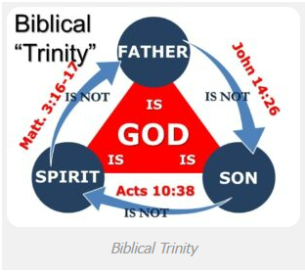
Qualifications for Prayer
Trinitarian Formula

Slide 11
Qualifications for Prayer
Trinitarian Formula
Matthew 3:¹⁶ After Jesus was baptized, he came up from the water and behold, the heavens were opened [for him], and he saw the Spirit of God descending like a dove [and] coming upon him. ¹⁷ And a voice came from the heavens, saying, “This is my beloved Son, with whom I am well pleased.” Donald Senior; John Collins; Mary Ann Getty. The Catholic Study Bible (p. 5136). Oxford University Press. Kindle Edition.
John 14:²⁶“ When the Advocate comes whom I will send you from the Father, the Spirit of truth that proceeds from the Father, he will testify to me. Donald Senior; John Collins; Mary Ann Getty. The Catholic Study Bible (p. 5586). Oxford University Press. Kindle Edition.
Acts 10:³⁸ how God anointed Jesus of Nazareth with the holy Spirit and power. He went about doing good and healing all those oppressed by the devil, for God was with him. Donald Senior; John Collins; Mary Ann Getty. The Catholic Study Bible (p. 5680). Oxford University Press. Kindle Edition.

Slide 12
Qualifications for Prayer
Trinitarian Formula
The Unity and Trinity of God (Catechism of the PNCC)

Slide 13
Qualifications for Prayer
Trinitarian Formula

Slide 14
Qualifications for Prayer
Trinitarian Formula

Slide 15
Qualifications for Prayer
Trinitarian Formula

Slide 16
Qualifications for Prayer
Trinitarian Formula

Slide 17
Qualifications for Prayer
Trinitarian Formula
Salvation and Sanctification
PNCC ELEVEN GREAT PRINCIPLES
III. SALVATION, THE CONDITION OF ENTERING THE KINGDOM OF GOD
Religion is the living bond uniting man with God; it is the most powerful, most noble and holy sentiment of the human heart and the highest degree of human intellect. It arises in the mystery of the soul, reveals itself through faith, unbounded trust and good social deeds.

Slide 18
Qualifications for Prayer
Trinitarian Formula
No one should, therefore, debase, ridicule, or traffic in religion, or use it for his own personal gain. Whoever does this, exposes himself to the dreadful consequences, rejection by God and humanity. History brands none so severely as those who traffic in God, virtue, faith and the sacraments; brands them as blasphemers, perjurers, sacrilegious, and destroyers of that which is sacred.

Slide 19
Qualifications for Prayer
Trinitarian Formula
“Woe, shepherds of Israel,” cried the great Israelite prophet to all those who abuse religion by using it to serve their low, base and selfish purposes, “who have been feeding yourselves! Should not shepherds feed the sheep? You eat the fat, you clothe yourselves with the wool, you slaughter the fatlings; but you do not feed the sheep. The weak you have not strengthened, the sick you have not healed, the crippled you have not bound up, the strayed you have not brought back, the lost you have not sought, and with force and harshness you have ruled them. So they were scattered, because there was no shepherd; and they became food for all the wild beasts.

Slide 20
Qualifications for Prayer
Trinitarian Formula
My sheep were scattered, they wandered over all the mountains and on every high hill; my sheep were scattered over all the face of the earth with none to search or seek for them. Therefore, you shepherds, hear the word of the Lord: As I live, says the Lord god, because my sheep have become a prey, and my sheep have become food for all the wild beasts, since there was no shepherd; and because my shepherds have not searched for my sheep, but the shepherds have fed themselves, and have not fed my sheep; therefore, you shepherds, hear the word of the Lord: thus says the Lord God, behold, I am against the shepherds; and I will require my sheep at their hand, and put a stop to their feeding the sheep; no longer shall the shepherds feed themselves. I will rescue my sheep from their mouths, that they may not be food for them.” (Ezekiel 34:2-10)

Slide 21
Qualifications for Prayer
Trinitarian Formula
Were not these prophetic words fulfilled in the course of human history, on the priests of Egypt, Judea and Rome? Might they not likewise be fulfilled on the Polish priests if they turn not from their course of disloyalty toward God? The same causes bring the same results. The same hand which wrote on the wall of the Babylon palace Mene, Tekel, Upharsin may likewise write down in Warsaw, Cracow, Poznan, Lwow, Lodz, Vilna and Czestochowa. “Woe.” (THE ELEVEN GREAT PRINCIPLES OF THE POLISH NATIONAL CATHOLIC CHURCH By The Most Reverend Francis Hodur)

Slide 22
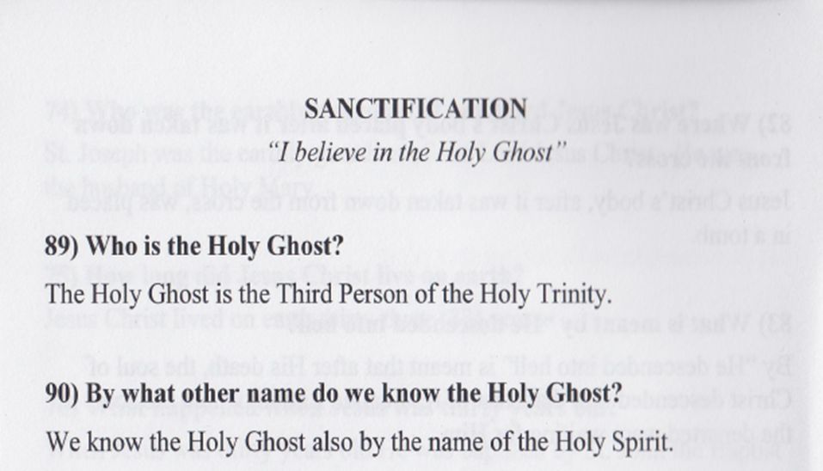
Qualifications for Prayer
Trinitarian Formula

Slide 23
Qualifications for Prayer
Trinitarian Formula

Slide 24
Qualifications for Prayer
Trinitarian Formula

Slide 25
Qualifications for Prayer
Trinitarian Formula
Personal prayer is an intimate conversation between an individual and the divine. It occurs in the quiet chambers of the heart, away from the bustling world. When we engage in personal prayer, we express our innermost thoughts, feelings, and desires directly to the divine presence. It’s a sacred space where we pour out our joys, sorrows, gratitude, and supplications. Personal prayer is deeply personal, unique to each person, and often unscripted.

Slide 26
Qualifications for Prayer
Trinitarian Formula
Communal prayer transcends the boundaries of individuality. It is a collective expression of faith, shared by a community of believers. Communal prayer includes liturgical rituals and acts of worship performed together. Here are the key differences:
Nature:
Personal Prayer: Intimate, individual, and spontaneous.
Communal Prayer: Shared, structured, and often guided by tradition.
Participants:
Personal Prayer: Involves one person connecting with the divine.
Communal Prayer: Involves a group of people praying together.

Slide 27
Qualifications for Prayer
Trinitarian Formula
Setting:
Personal Prayer: Can happen anywhere, even in solitude.
Communal Prayer: Often takes place in religious gatherings, churches, synagogues, mosques, or temples.
Purpose:
Personal Prayer: Reflects personal needs, emotions, and spiritual growth.
Communal Prayer: Serves the entire community, expressing shared faith and devotion.
Examples:
Personal Prayer: Silent meditation, spontaneous conversations with God, personal petitions

Slide 28
Qualifications for Prayer
Trinitarian Formula
Lord Jesus, grant us your Grace, grant us strength, grant us perseverance to do your will. Amen.
End of Spirituality IV

