Slide 1
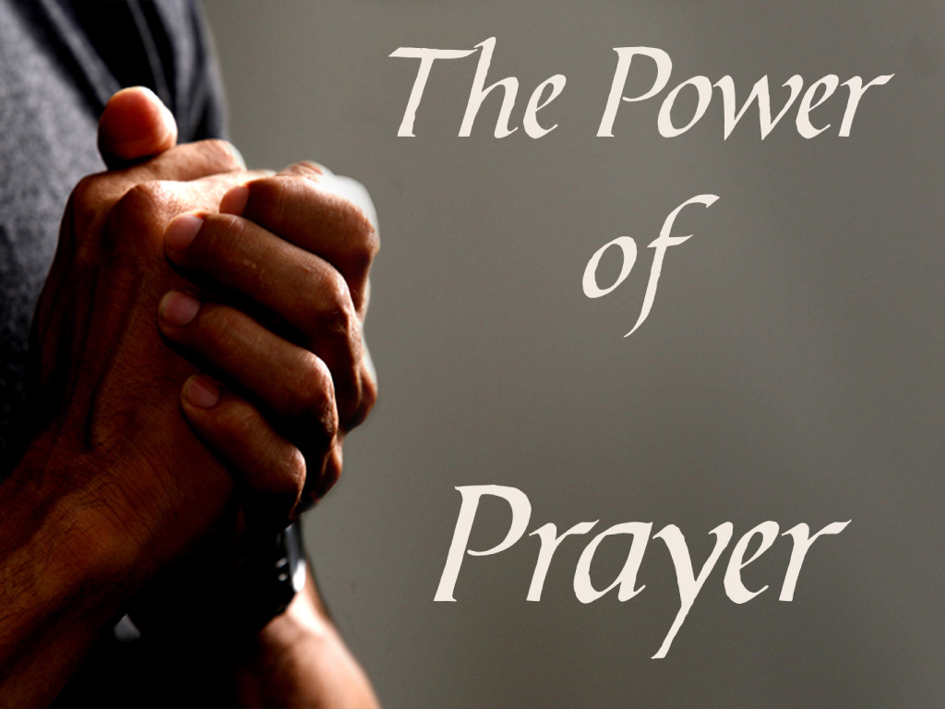
Qualifications for Prayer Spirituality II

Slide 2
Prayer
Prayer and praying
“We pursue God because, and only because, He has first put an urge within us that spurs us to the pursuit. ‘No man can come to me,’ said our Lord, ‘except the Father which hath sent me draw him,’ and it is by this very drawing that God takes from us every bit of credit for the act of coming. The impulse to pursue God originates with God, but the outworking of that impulse is our following hard after Him; and all the time we are pursuing Him we are already in His hand: ‘Thy right hand upholdeth me.’ In this divine ‘upholding’ and human ‘following’ there is no contradiction. All is of God, for as von Hugel teaches, God is always previous.” Tozer, A. W.. The Pursuit of God (pp. 8-9). Start Publishing LLC. Kindle Edition

Slide 3
Prayer
Prayer and praying
“In practice, however, (that is, where God’s previous working meets man’s present response) man must pursue God. On our part there must be positive reciprocation if this secret drawing of God is to eventuate in identifiable experience of the Divine. In the warm language of personal feeling this is stated in the Forty-second Psalm: ‘As the hart panteth after the waterbrooks, so panteth my soul after thee, O God. My soul thirsteth for God, for the living God: when shall I come and appear before God?’ This is deep calling unto deep, and the longing heart will understand it.” Tozer, A. W.. The Pursuit of God (pp. 8-9). Start Publishing LLC. Kindle Edition.

Slide 4
You Are My All in All by Dennis Jernigan
You are my strength when I am weak
You are the treasure that I seek
You are my all in all
Seeking You as a precious jewel
Lord to give up, I’d be a fool
You are my all in all
Taking my sin, my cross, my shame
Rising again I bless Your name
You are my all in all
When I fall down You pick me up
When I am dry, You fill my cup
You are my all in all

Slide 5
Prayer
We will be referencing this first of a series on prayer called - Thoughts Matter: The Practice of the Spiritual Life; Mary Margaret Funk OS/B, Continuum, New York, 2005
Through the process described in the book we will gain a better insight and a process to deepen our prayer life so we may better hear that small voice within us.
The process was developed through Mary Margaret’s experience with the Benedictine Monks.

Slide 6
About Thoughts
If God is our heart’s desire, then the heart knows its own path. All seekers somehow sense along the way the magnetism of the journey. However, through reflection on the teachings of the early desert hermits we can learn how the earliest Christians came to the mystical relationship with God that we, too, long for, not in the next life, but in this earthly one. The lives of the two hundred desert fathers and mothers that Cassian speaks about in his Institutes and Conferences show clearly that it isn’t enough to make a good resolution about one’s intentions; deeds must follow.

Slide 7
About Thoughts
However, it isn’t that simple either. Deeds must be accompanied by right intentions. Serious seekers must train their minds to keep their goal ever before their consciousness. This interior work – this training of the mind – takes practice, a practice tradition calls the “ascetical life.” Mary Margaret went to the monastery for what she thought was to do ministry of teaching, nursing or pastoral services. She discovered that the primary purpose of the Benedictine culture was to train one for the inner life. Only when she sensed the power of her thoughts, was she able to renounce them and hear the small voice of God deep inside.
We will follow her analogy and her process so we may gain a stronger hearing of that small inner voice of God deep inside of us.

Slide 8
About Thoughts
Thinkers many years before had discovered that there were clusters of themes that recurred over and over in the silence of their hearts, thoughts about food, sex, things, anger, dejection, acedia (spiritual or mental sloth; apathy), vainglory (excessive pride in one’s achievements), and pride. The wrestling with these thoughts they considered the negative part of the practice of controlling them; the alternate, positive action was to fill their minds with inspired and traditional prayers. Cassian used the term lectio and Benedict used both lectio and lectio divina to recommend the practice of this traditional form of prayer for Christians. This particular method of sacred reading provided a way to listen to the Scriptures with the ear of one’s heart.

Slide 9
About Thoughts
The work of every one of us is interior work, the practice of training our thoughts ^{(p14).} The major obstacle is sin, or turning away from our Creator who made us to be in the likeness of God. Sin is the end stage of wrong thoughts, desires, and passions. Sin promotes a vicious life of evil. We can reverse this tendency by using our thoughts, desires, and passions for good. This is a virtuous life of Grace.
To know our thoughts is an essential step in redirecting our heart to God in prayer. And whether flight is to monastery or desert cave, the key practice leading us to know our thoughts, and to renounce our thoughts is silence. Wisdom tells us that silence will teach us everything. ^{(p23)}

Slide 10
Thoughts of Food
The first of the eight thoughts treated is thinking of food. As stated earlier, the earliest training for a novice in the spiritual life is to notice we have thoughts and the major reason work of the spiritual journey is so difficult is because we seldom notice these thoughts. ^{(p26)} We generally live life in a cloud unthinking totally unaware of the inner stirrings and sensitivities of our hearts. Fasting is a good practice to adopt as we start serious work in the spiritual life. Most people think of fasting as eating nothing for long periods of time. However, it is taught that we should simply put food and our thoughts about food into proper balance, eating only at meals and not in between. Refrain from eating too much, but also refrain from eating too little. Eat at the designated time. Refrain from eating before and after meals. When food becomes my dominant though, it becomes the center of my interior life. ^{(p27)}

Slide 11
Thoughts of Food
The content of the first of eight thoughts, food, is not so much about food as it is about the practice of using food thought as a training tool. As we will see with the other seven thoughts, what the thought is does not matter; what matters is how I redirect my thought to God. The renunciation is the first stage in leading to prayer; to lift up my thoughts and mind to God. ^{(p28)}

Slide 12
About Sex
The second thought, about sex, is generally not about a beloved qualities but about the physical or emotional needs he or she represents. Other means to offset these thoughts are physical exercise, maintaining distance from the person who is the object of the passion, and working through ordinary consciousness. The demands that sex makes on us produce a lifetime of struggle, even for the higher saints. (these thoughts can also be directed in the inappropriate direction). ^{(p37)}
The inter-relational work of married couples, whether living in a household a monastery our egos must be diminished for the sake of the larger good. Yet to diminish the ego isn’t the goal of the spiritual life. The goal is love. ^{(p42)}

Slide 13
About Sex
Appropriate practices to control “sex thoughts” include keeping a distance from outside relationships and environments that stimulate sexual excitement, thoughts, desires or passions that are not appropriate to my vocation. (Husband, wife, Deacon, Priest) ^{(p44)}
No matter what method one uses, the practice is to notice the first inkling of desire and move it out of consciousness by laying the thought aside or saying a short prayer. ^{(p45)}
Sex is good, but like food it can consume me rather than nourish my body, mind and soul. ^{(p50)}

Slide 14
About Things
From a spiritual point of view, anything is an illusion. At best, all we do is use a thing. However, we desire, obtain, use, and secure more and more of them. This “getting of things” tends to fan the fire of desire to get more things the next time. Things are more seductive than sex.
The teaching about things is not about things in themselves. It points primarily to our personal attachment to things. I take care of things because these objects are gifts on loan to me, not because they are mine.

Slide 15
About Things
A healthy marriage demands the same as a monastic practice of total renunciation. All is shared. The family pools assets. Priorities are established. Each person yields to the common good while personal needs are met as well as they can be. The household is the monastery. Goods are shared according to need. Things mediate love and compassion. Things are not owned, but are tools for charity. Desire for things has no grip. Desires are redirected to responsible action on behalf of justice to others. ^{(p64)}
Things and desire for things often feed on our soul. When we are deprived of things, anger can arise within us. Is this a sign that we need things for healthy development? What happens when one doesn’t have the things that one needs? ^{(p65)}
We are encouraged to stay involved with a Christian community that values sharing goods, reaching out to the poor, and caring for all the goods of the earth

Slide 16
About Anger
The thought of “about anger” rises in each on of us. Anger is a response that is frequent, habitual, and sometimes seems apparently uncontrollable. We often adjust to bouts of anger in ourselves and in others. In order to live the spiritual life, we must reduce our angry impulses, refrain from acting out of anger, and strive to resist even thoughts of anger. Anger is a learned behavior and can be unlearned. This Christian teaching says we act rightly and justly, never out of angry feelings. ^{(p66)}
In the context of original sin, anger is a consequence of the cumulative sin we have inherited. If we heap our own anger upon others, the cycle continues. However the grace given to each baptized Christian reverses that tendency. In the spiritual life, through grace I am able to root out anger from my heart. ^{(p66)}

Slide 17
About Anger
If I am full of anger, I am blind; I have lost the capacity to give proper counsel and no longer enjoy the confidence of right thinking and acting. My spiritual capacity is diminished and true light is dimmed within me. I start quarrels and lose the esteem of others. The most compelling indictment against anger is that this blindness disqualifies me from spiritual work since I am out of relationship with myself and others and with God. I cannot discern. If that is not enough to give me pause the reaching goes on to say that unchecked anger leads to depression, madness, and universal disharmony. The corrective is to seek peace and to do the interior work necessary to dismantle angry thoughts. ^{(p67)}

Slide 18
About Anger
Anger may be caused by a minor incident or a major crime; that makes no difference to a practitioner. Any anger causes distraction and misguided actions. When I am angry, both my own soul and that of another person are equally inaccessible. ^{(p70)}
It is recommended that frequent reading and continual meditation on the Scriptures, frequent singing of the Psalms, earnest vigils, fasting, and prayer. These spiritual practices keep the mind thinking noble thoughts and anger, lust, or greed have little room to grow. Preferring spiritual realities (thoughts toward God) over worldly concerns (thoughts toward the ego) is what is often called recollection. ^{(p73)}

Slide 19
About Anger
All our images, concepts, and stored feelings walk to the pew with us. On the outside we may look like we are praying, but on the inside, we are engaged in previous conversations. We are told that practices concerning thoughts about food, sex, things, and anger, are ascetical prerequisites to enter into a deep spiritual life of union with God, not sometime in eternity, but now on this earth, during our lifetime. ^{(p74)}

Slide 20
Closing
We end this portion of “Thoughts Matter” but will continue in our next lesson to discuss;
About Dejection, About Acedia, About Vainglory, About Pride and Qualifications for praying.
Dear Lord, please free our minds of distractions so we might be in communion with you. Guide our thoughts and actions this day and in future days. Protect all those we love and cherish, and forgive me for those I may have hurt. Guide us all we do, say and think. In Jesus name we pray. Amen .

