Slide 1
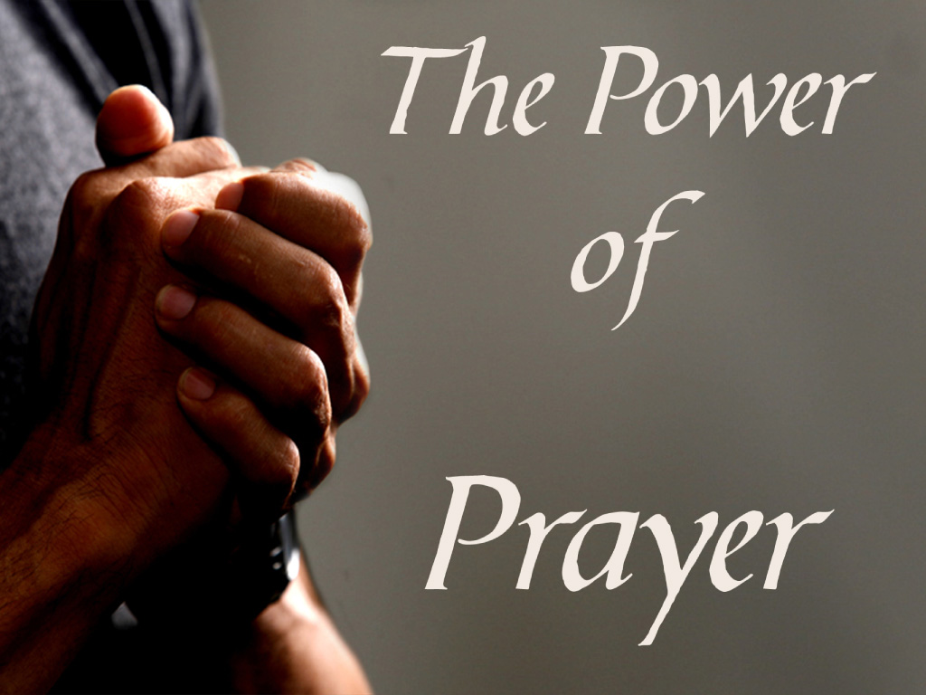
Prayer Spiritual Formation

Slide 2
Prayer
Prayer and praying
“Prayer is alien to our proud human nature. And yet somewhere, someplace, probably all of us reach the point of falling to our knees, bowing our heads, fixing our attention on God and praying. We may look both ways to be sure no one is watching; we may blush; but in spite of the foreignness of the activity, we pray.” Why are we drawn to pray? (Hybels, 1988)

Slide 3
Prayer
“By prayer, however, a man shows reverence to God inasmuch as he submits himself to Him and, by praying, acknowledges that he needs God as the Author of all his good. Prayer belongs to the intellectual faculties” “We must remember that the will moves the other faculties of the soul to their objects or ends, and that consequently the virtue of religion, which is in the will, directs the acts of the other faculties in the reverence they show towards God. Now amongst these other faculties of the soul the intellect is the noblest and the most nigh to the will; consequently, next to devotion, which belongs to the will itself, prayer, which belongs to the intellective part, is the chief act of religion, for by it religion moves a man's understanding towards God.” Aquinas, Saint Thomas. On Prayer and The Contemplative Life (p. 25). Kindle Edition. There are different types of prayer:

Slide 4
Prayer
“Acts of worship fall under precept, whereas prayer seems to fall under no precept, but to proceed simply from the mere wish to pray; for prayer is merely asking for what we want; consequently prayer is not an act of the virtue of religion. Yet not only to ask for what we desire, but to desire rightly, falls under precept; to desire, indeed, falls under the precept of charity, but to ask falls under the precept of religion—the precept which is laid down in the words: Ask and ye shall receive. Lastly, the virtue of religion embraces due worship and ceremonial offered to the Divinity; prayer, however, offers God nothing, but only seeks to obtain things from Him. ” Aquinas, Saint Thomas. On Prayer and The Contemplative Life (p. 25). Kindle Edition.

Slide 5
Prayer and Praying
“In prayer a man offers to God his mind, which he subjects to Him in reverence, and which he, in some sort, lays bare before Him. Hence, since the human mind is superior to all the other exterior or bodily members, and also to all exterior things which have place in the Divine worship, it follows that prayer, too, is pre-eminent among the acts of the virtue of religion. Cajetan (note following slide): In prayer or petition there are three things to be considered: the thing petitioned for, the actual petition, and the petitioner. As far, then, as the thing petitioned for is concerned, we give nothing to God when we pray; rather we ask Him to give us something. But if we consider the actual petition, then we do offer something to God when we pray. For the very act of petitioning is an act of subjection; it is an acknowledgment of God's power. And the proof of this is that proud men would prefer to submit to want rather than humble themselves by asking anything of others. Aquinas, Saint Thomas. On Prayer and The Contemplative Life (pp. 25-26). Kindle Edition.

Slide 6
Prayer and Praying
Thomas Cajetan, OP; 20 February 1469 – 9 August 1534), also known as Gaetanus, commonly Tommaso de Vio or Thomas de Vio, was an Italian philosopher, theologian, the Master of the Order of Preachers 1508 to 1518, and cardinal from 1517 until his death. He was a leading theologian of his day who is now best known as the spokesman for Catholic opposition to the teachings of Martin Luther and the Protestant Reformation while he was the Pope's legate in Augsburg, and among Catholics for his extensive commentary on the Summa Theologica of Thomas Aquinas.

Slide 7
Prayer and Praying
“Further, the petitioner, by the very fact that he petitions, acknowledges that he whom he petitions has the power to assist him, and is merciful, or just, or provident; it is for this reason that he hopes to be heard. Hence petition or prayer is regarded as an act of the virtue of religion, the object of which is to give honour to God. For we honour God by asking things of Him, and this by so much the more as—whether from our manner of asking or from the nature of what we ask for—we acknowledge Him to be above all things, to be our Creator, our Provider, our Redeemer, etc. And this is what S. Thomas points out in the body of the Article. But if we consider the petitioner: then, since man petitions with his mind—for petition is an act of the mind—and since the mind is the noblest thing in man, it follows that by petitioning we submit to God that which is noblest in us, since we use it to ask things of Him, and thereby do Him honour. Thus by prayer we offer our minds in sacrifice to God; so, too, by bending the knee to Him we offer to Him and sacrifice to Him our knees, by using them to His honour (on 2. 2. 83. 3). Aquinas, Saint Thomas. On Prayer and The Contemplative Life (pp. 25-26). Kindle Edition.

Slide 8
Prayer and Praying
“S. Augustine: I stand as a beggar at the gate, He sleepeth not on Whom I call! Oh, may He give me those three loaves! For you remember the Gospel? Ah! see how good a thing it is to know God's word; those of you who have read it are stirred within yourselves! For you remember how a needy man came to his friend's house and asked for three loaves. And He says that he sleepily replied to him: "I am resting, and my children are with me asleep." But he persevered in his request, and wrung from him by his importunity what his deserts could not get. But God wishes to give; yet only to those who ask—lest He should give to those who understand not. He does not wish to be stirred up by your weariness! For when you pray you are not being troublesome to one who sleeps; He slumbereth not nor sleeps that keepeth Israel. [119] ... He, then, sleeps not; see you that your faith sleeps not! (Enarr. in Ps. cii. 10).” Aquinas, Saint Thomas. On Prayer and The Contemplative Life (p. 26). Kindle Edition.

Slide 9
Types of Prayer
David's Prayer of Gratitude
2 Sam 7:18 Then King David went in and sat before the LORD and said, “Who am I, O Lord GOD, and what is my house, that you have brought me thus far? 19 And yet this was a small thing in your eyes, O Lord GOD. You have spoken also of your servant's house for a great while to come, and this is instruction for mankind, O Lord GOD! 20 And what more can David say to you? For you know your servant, O Lord GOD! 21 Because of your promise, and according to your own heart, you have brought about all this greatness, to make your servant know it. 22 Therefore you are great, O LORD God. For there is none like you, and there is no God besides you, according to all that we have heard with our ears. 23 And who is like your people Israel, the one nation on earth whom God went to redeem to be his people, making himself a name and doing for them⁴ great and awesome things by driving out⁵ before your people, whom you redeemed for yourself from Egypt, a nation and its gods?” 2 Sam 7:18-29

Slide 10
Types of Prayer
David's Prayer of Gratitude
2 Sam 7:24 And you established for yourself your people Israel to be your people forever. And you, O LORD, became their God. 25 And now, O LORD God, confirm forever the word that you have spoken concerning your servant and concerning his house, and do as you have spoken. 26 And your name will be magnified forever, saying, ‘The LORD of hosts is God over Israel,’ and the house of your servant David will be established before you. 27 For you, O LORD of hosts, the God of Israel, have made this revelation to your servant, saying, ‘I will build you a house.’ Therefore your servant has found courage to pray this prayer to you. 28 And now, O Lord GOD, you are God, and your words are true, and you have promised this good thing to your servant. 29 Now therefore may it please you to bless the house of your servant, so that it may continue forever before you. For you, O Lord GOD, have spoken, and with your blessing shall the house of your servant be blessed forever.” 2 Sam 7:18-29

Slide 11
Types of Prayer
Solomon's Prayer of Dedication
1 Kings 8:22 Then Solomon stood before the altar of the LORD in the presence of all the assembly of Israel and spread out his hands toward heaven, 23 and said, “O LORD, God of Israel, there is no God like you, in heaven above or on earth beneath, keeping covenant and showing steadfast love to your servants who walk before you with all their heart; 24 you have kept with your servant David my father what you declared to him. You spoke with your mouth, and with your hand have fulfilled it this day. 25 Now therefore, O LORD, God of Israel, keep for your servant David my father what you have promised him, saying, ‘You shall not lack a man to sit before me on the throne of Israel, if only your sons pay close attention to their way, to walk before me as you have walked before me.’ 26 Now therefore, O God of Israel, let your word be confirmed, which you have spoken to your servant David my father. 1 Kings 8:22-27

Slide 12
Types of Prayer
Prayer Pleading
1 Kings 8:27 “But will God indeed dwell on the earth? Behold, heaven and the highest heaven cannot contain you; how much less this house that I have built! 28 Yet have regard to the prayer of your servant and to his plea, O LORD my God, listening to the cry and to the prayer that your servant prays before you this day, 29 that your eyes may be open night and day toward this house, the place of which you have said, ‘My name shall be there,’ that you may listen to the prayer that your servant offers toward this place. 30 And listen to the plea of your servant and of your people Israel, when they pray toward this place. And listen in heaven your dwelling place, and when you hear, forgive. 1 Kings 8:27-30

Slide 13
Types of Prayer
Eliphaz Accuses: Job Does Not Fear God
Job 15:3 Should he argue in unprofitable talk, or in words with which he can do no good?
Job 15:4 But you are doing away with the fear of God and hindering meditation before God.
Job 15:5 For your iniquity teaches your mouth, and you choose the tongue of the crafty.
Job 15:6 Your own mouth condemns you, and not I; your own lips testify against you.

Slide 14
Types of Prayer
Jonah's Prayer
2:1 Then Jonah prayed to the LORD his God from the belly of the fish, 2 saying, “I called out to the LORD, out of my distress, and he answered me; out of the belly of Sheol I cried,and you heard my voice. 3 For you cast me into the deep, into the heart of the seas, and the flood surrounded me; all your waves and your billows passed over me. 4 Then I said, ‘I am driven away from your sight; yet I shall again look upon your holy temple.’ 5 The waters closed in over me to take my life; the deep surrounded me;weeds were wrapped about my head 6 at the roots of the mountains. I went down to the land whose bars closed upon me forever; yet you brought up my life from the pit,
O LORD my God. 7 When my life was fainting away, I remembered the LORD, and my prayer came to you, into your holy temple. 8 Those who pay regard to vain idolsforsake their hope of steadfast love. 9 But I with the voice of thanksgiving will sacrifice to you; what I have vowed I will pay. Salvation belongs to the LORD!” 10 And the LORD spoke to the fish, and it vomited Jonah out upon the dry land. Jonah 2:1-10

Slide 15
Types of Prayer
Longing to Go to Rome (St. Paul)
Romans 1:8 First, I thank my God through Jesus Christ for all of you, because your faith is proclaimed in all the world. 9 For God is my witness, whom I serve with my spirit in the gospel of his Son, that without ceasing I mention you 10 always in my prayers, asking that somehow by God's will I may now at last succeed in coming to you. Roman 1:8-10

Slide 16
Types of Prayer
Pray for All People
1 Timothy 2:1 First of all, then, I urge that supplications, prayers, intercessions, and thanksgivings be made for all people, 2 for kings and all who are in high positions, that we may lead a peaceful and quiet life, godly and dignified in every way. 3 This is good, and it is pleasing in the sight of God our Savior, 4 who desires all people to be saved and to come to the knowledge of the truth. 5 For there is one God, and there is one mediator between God and men, the man¹ Christ Jesus, 6 who gave himself as a ransom for all, which is the testimony given at the proper time. 7 For this I was appointed a preacher and an apostle ( I am telling the truth, I am not lying), a teacher of the Gentiles in faith and truth. 1 Timothy 2:1-7

Slide 17
Types of Prayer
The Lord’s Prayer
Let us pray with confidence to the Father in the words our Savior gave us:
The celebrant extends his hands and sings or says with the congregation:
Our Father, who art in heaven,
hallowed be Thy Name,
Thy Kingdom come,
Thy will be done,
on earth as it is in heaven.
Give us this day our daily bread.
And forgive us our trespasses
as we forgive those
who trespass against us.
And lead us not into temptation,
but deliver us from evil.

Slide 18
Types of Prayer
"May God have mercy on us, and bless us: may He cause the light of His countenance to shine upon us, and may He have mercy on us. That we may know Thy way upon earth: Thy salvation in all nations. Let people confess to Thee, O God: let all people give praise to Thee. Let the nations be glad and rejoice: for Thou judgest the people with justice, and directest the nations upon earth. Let the people, O God, confess to Thee: let all the people give praise to Thee: the earth hath yielded her fruit. May God, our God bless us, may God bless us: and all the ends of the earth fear Him.“ Aquinas, Saint Thomas. On Prayer and The Contemplative Life (p. 28). Kindle Edition.

Slide 19
Ways to Pray
Ways to pray:
Mental prayer ;”Again, prayer to those who cannot know what we pray for is idle. But God alone can know our prayers, and this because prayer is frequently a purely interior act of which God alone is cognizant, as the Apostle says: I will pray with the spirit.” Aquinas, Saint Thomas. On Prayer and The Contemplative Life (p. 27). Kindle Edition.
“But to the Blessed, as S. Gregory says, manifestation is made in the Divine Word of those things which it is fitting that they should know as taking place in our regard, even the interior movements of the heart. And, indeed, it is most befitting their state of excellence that they should be cognizant of petitions addressed to them, whether vocally or mentally. Hence through God's revelation they are cognizant of the petitions which we address them.” Aquinas, Saint Thomas. On Prayer and The Contemplative Life (pp. 27-28). Kindle Edition.

Slide 20
Ways to Pray
Ways to pray
“some say: if we do address prayers to any of the Saints, the sole reason for doing so lies in the fact that they are closely united to God. But we do not address prayers to people who, while still living in this world, are closely knit to God, nor to those who are in Purgatory and are united to Him. There seems, then, to be no reason why we should address prayers to the Saints in Paradise.”
“But they who are still in the world or in Purgatory do not as yet enjoy the vision of the Divine Word so as to be able to know what we think or say, hence we do not implore their help when we pray; though when talking with living people we do ask them to help us.” Aquinas, Saint Thomas. On Prayer and The Contemplative Life (p. 28). Kindle Edition.

Slide 21
Ways to Pray
Ways to pray
“To live a life of prayer means that you are devoted to it, and that prayer has become a habit as simple as breathing. A believer with a successful prayer life is someone that runs to God whenever there is a moment that they’re free from responsibilities.”
“A perfect example of this is Jesus.
Jesus would wake up well before the sun rose to spend time with His Father through prayer.
“Now in the morning, having risen a long while before daylight, He went out and departed to a solitary place, and there He prayed.” (Mark 1:35)”
Live a Life of Prayer: What does it mean & How to do it – https://thebiblicalfoundation.com/live-a-life-of-prayer-what-does-it-mean-how-to-do-it/

Slide 22
Ways to Pray
Ways to pray
Intercessory
Hence it is said in the Apocalypse: And the smoke of the incense of the prayers of the Saints ascended up before God from the hand of the Angel. And this is clearly shown, too, from the style adopted by the Church in her prayers: for of the Holy Trinity we pray that mercy may be shown us; but of all the Saints, whomsoever they may be, we pray that they may intercede for us.
Aquinas, Saint Thomas. On Prayer and The Contemplative Life (p. 27). Kindle Edition.

Slide 23
Ways to Pray
Ways to pray
Liturgical – prayer in community within the service
Meditation – Thoughtful, quiet, contemplative prayer

Slide 24
Ways to Pray
The Liturgy of the Hours, also known as the Divine Office or the Work of God (Opus Dei), is the daily prayer of the Church, marking the hours of each day and sanctifying the day with prayer. The Hours are a meditative dialogue on the mystery of Christ, using scripture and prayer. It is the very prayer which Christ himself together with his Body addresses to the Father." The dialogue is always held, however, in the presence of God and using the words and wisdom of God. Each of the five canonical Hours includes selections from the Psalms that culminate in a scriptural proclamation. The two most important or hinge Hours are Morning and Evening Prayer. These each include a Gospel canticle: the Canticle of Zechariah from Luke 1:68-79 for Morning Prayer (known as the Benedictus), and the Canticle of Mary from Luke 1:46-55 for Evening Prayer (known as the Magnificat). The Gospel canticle acts as a kind of meditative extension of the scriptural proclamation in light of the Christ event. Morning and Evening Prayer also include intercessions that flow from the scriptural proclamation just as the Psalms prepare for it. https://www.usccb.org/prayer-and-worship/liturgy-of-the-hours

Slide 25
Ways to Pray
Extemporaneous prayers; we speak whatever our heart tells us, we say the words we feel led to utter. These prayers are sometimes participatory, making space for multiple people to interject their own petitions into the basic shape of the prayer.
When asked to pray for someone “on the spot” there is not a resource available to read a prayer, so a minister must be able to pray from the heart with the intention being the subject of the prayer. (praying for a sick friend, or someone going into surgery, or other concern.)
Also in daily pray we pray for family and friends, the church, other ministers, etc. from our hearts.
If all else fails, the Lord’s prayer is a good start.

