Slide 1
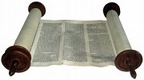
Bible Study Class 3 Old Testament

Slide 2
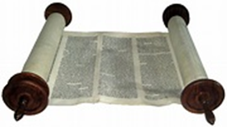
Bible Study – Class 3
The Old Testament: Torah (Pentateuch)
“The first five books of the Bible (Genesis, Exodus, Leviticus, Numbers, Deuteronomy) tell the story of the prehistory of Israel, from the creation to the death of Moses on the threshold of the promised land. Genesis 1-11 deals with the primeval history, from creation to the flood, and the Tower of Babel. Genesis 12-50 is the patriarchal history, the stories of Abraham, Isaac, Jacob, and the sons of Jacob. The Joseph story, in Genesis 37-50, is a distinct block of material within this corpus. It is a transitional story that explains how Israel came to be in Egypt, and thereby set the stage for exodus. Exodus 1-18 tells the story of the liberation from Egypt. Then Exodus 19-40 and the book of Leviticus present the revelation at Mount Sinai. The book of Numbers describes the sojourn in the wilderness. Finally, Deuteronomy is the farewell address of Moses.”
(Introduction to the Hebrew Bible; John J. Collins, 2004, Fortress Press, p47)

Slide 3
Bible Study – Class 3
The Old Testament: Torah (Pentateuch)
Genesis
The Book of Origins. The origin of the universe, the human race, etc. Largely a record of the early history of the chosen people.
Exodus
The bondage, deliverance, and beginning of history of Israel on the way to Canaan under the leadership of Moses.
Leviticus
The book of laws concerning morals, cleanliness, food, etc. It teaches access to God through sacrifices.
Numbers
The book of the pilgrimages of Israel, the forty years wandering in the wilderness.
Deuteronomy
A repetition of the laws given shortly before Israel entered Canaan.

Slide 4
Bible Study – Class 3
The Old Testament: Torah (Pentateuch)
Genesis
The Book of Origins. The origin of the universe, the human race, etc. Largely a record of the early history of the chosen people
The History of Creation
a. Of our universe 1:1-25
b. Of man. 1:26-31; 2:18-24

Slide 5
Bible Study – ClASS 3
The Old Testament: Torah (Pentateuch)
Genesis
II. The story of primeval man
a) The temptation and Fall, the personality and character of the tempter, the penalty of sin, and the promise of a coming Redeemer, chap 3
b) The story of Cain and Abel, chap 4
c) The genealogy and death of the patriarchs, chap 5
d) The events connected with the Flood, chap 6 - 8
e) The rainbow covenant and Noah’s sin, chap 9
f) The descendants of Noah, chap 10
g) The confusion of language at Babel, chap 11

Slide 6
Bible Study – Class 3
The Old Testament: Torah (Pentateuch)
Genesis
III. The history of the chosen people (1)
The career of Abraham
a) His divine call, chap 12
b) The story of Abraham and Lot chap 13 -14
c) The divine revelations and promises to Abraham, particularly the promise of a son, of the possession of the Holy Land, and of great prosperity, chap 15 - 17
d) His intercession for the cities of the plain, and their destruction chap 18 - 19
e) His life at Gerar, and the fulfillment of the promise of a son in the birth of Isaac chap 20 - 21
f) The test of his obedience by the divine command to sacrifice Isaac, chap 22
g) His death, 25:8

Slide 7
Bible Study – Class 3
The Old Testament: Torah (Pentateuch)
Genesis
III. The history of the chosen people (2)
The career of Isaac
a) His birth, 21:3
b) His marriage, chap 24
c) The birth of his son Jacob and Esau, 25:20-28
d) His later years, chap 26-27

Slide 8
Bible Study – Class 3
The Old Testament: Torah (Pentateuch)
Genesis
III. The history of the chosen people (3)
3) The career of Jacob
a) His craftiness in securing the birthright, 27:1- 29
b) His vision of the heavenly stairway 28:10-22
c) Incidents connected with his marriage and life in Paddan Aram, chap 29 -31
The career of Esau as related in Genesis
The career of Joseph, the later years of Jacob, and the descent of the chosen family
into Egypt chap 37 -50

Slide 9
Bible Study – Class 3
The Old Testament: Torah (Pentateuch)
Genesis
Five Great Spiritual Characters
Enoch the man who walked with God
Noah the ark builder
Abraham the father of the faithful - Isaac
Jacob the man whose life was transformed by prayer
Joseph the son of Jacob who rose from slavery to become the governor of Egypt

Slide 10
Bible Study – Class 3
The Old Testament: Torah (Pentateuch)
Exodus
The bondage, deliverance, and beginning of history of Israel on the way to Canaan under the leadership of Moses.
The stories in this book?
Baby Moses - Exodus chp 2
A burning bush - Exodus chp 3
The ten plagues - Exodus chp 7–11
The Passover - Exodus chp 12
Crossing the Red Sea - Exodus chp 14
The Ten Commandments - Exodus chp 20
Building the tabernacle - Exodus chp 25–27
Zondervan,. NIV, Kids' Visual Study Bible, Full Color Interior: Explore the Story of the Bible---People, Places, and History (p. 240). Zonderkidz. Kindle Edition.

Slide 11
Bible Study – Class 3
The Old Testament: Torah (Pentateuch) – Exodus (1)
The bondage, deliverance, and beginning of history of Israel on the way to Canaan under the leadership of Moses.
Synopsis; 4 periods in the history of Israel
I. The period of Bondage
The oppression in Egypt 1 – 12
The events in the early life of Moses
a) His birth and adoption 2:1-10
b) His attempt to aid his brothers 2:11-14
c) His escaped to Midian 2:15
d) His marriage 2:21 (40 years pass) Acts 7:30

Slide 12
Bible Study – Class 3
The Old Testament: Torah (Pentateuch) - Exodus (2)
II. The Period of Deliverance
The call of Moses at the burning Bush 3:1- 10
His divine Commission and empowering 3:12-22; and 4:1-9
His excuses 3:11; 4:10-13
Aaron associated with Moses in demanding that pharaoh liberate Israel 4:27-31; 5:1-3
The bondage made more severe 5:5-23
The divine instructions to Moses and Aaron chapter 6-7
The contest with Pharaoh and the infliction of the 10 plagues Chap7-11
The Passover chap 12

Slide 13
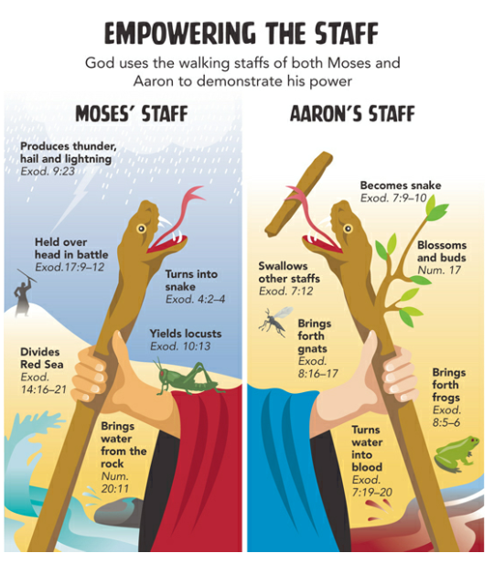
Bible Study – Class 3

Slide 14
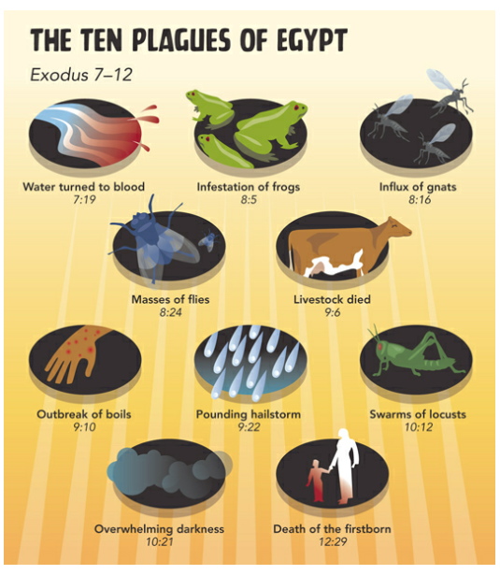
Bible Study – Class 3

Slide 15
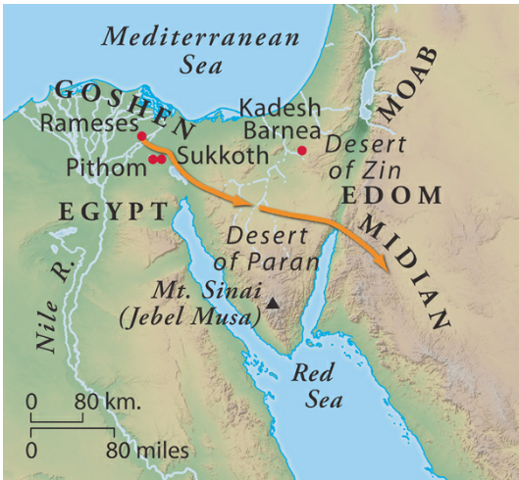
Bible Study – Class 3

Slide 16
Bible Study – Class 3
The Old Testament: Torah (Pentateuch) - Exodus (3)
III. The Period of Discipline
a) The Exodus chp 12:31-51
b) Experiences on the way to Mt. Sinai. Chp 13-18.
IV. The Period of Legislation and Organization
The arrival at Sinai chap 19:1-2
The appearance of the Lord on the mount chap 19
The giving of the 10 commandments chap 20
Other laws proclaimed chap 21-24
Directions concerning the building of the Tabernacle chap 25-27
The appointment of the high priest chap 28
The worship of the golden calf chap 32
The preparation for an erection of the Tabernacle chap 35-40

Slide 17
Bible Study – Class 3
The Old Testament: Torah (Pentateuch)- Exodus (4)
The Pilgrimage of Israel a type of the Christian Life (see 1Co 10:1-11).
The Egyptian bondage. A type of the bondage of sin.
Moses as deliverer. A type of Christ (parallel between Christ and Moses).
The Exodus, A type of the forsaking of the sinful life.
The Passover lamb, A type of Christ. The Lamb of God.
Pharaoh’s pursuit of Israel, 14:8-9; A type of the evil forces pursuing believers.
The opening of the Red Sea, 14:21; A type of hindrances removed.
The pilar of cloud and fire, 14:19-20; A type of the divine presence with believers.
The song of Moses, 15:1-19; A type of the songs of spiritual victory.

Slide 18
Bible Study – Class 3
The Old Testament: Torah (Pentateuch)- Exodus (5)
The mixed multitude, 12:38; A type of the worldly people in the church.
Marah and Elim, 15:23-27; A type of the bitter and sweet experiences of the spiritual life.
The pots of meat, 16:3, A type of the sensual pleasures of the old life.
The manna, 16:4, A type of Christ, the Bread of Life.
The water from the rock, 17:6, A type of Christ, the living water, 1Co 10:4
The upholding of Moses’ hands, 17:2, A type of the need of cooperation among leaders.
In the structure of the tabernacle, its furniture, ordinances, the garments of the priesthood, the ark of the covenant, etc., are found many types of Christ and the church.

Slide 19
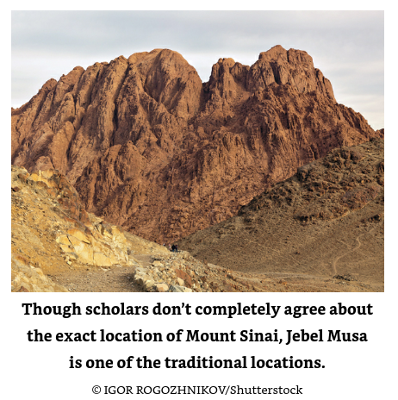
Bible Study – Class 3
The Old Testament: Torah (Pentateuch)- Exodus (6)

Slide 20
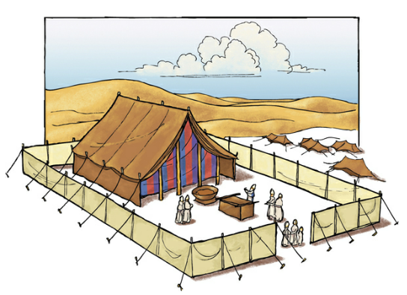
Bible Study – Class 3
The Old Testament: Torah (Pentateuch)- Exodus (7) – The Tabernacle

Slide 21
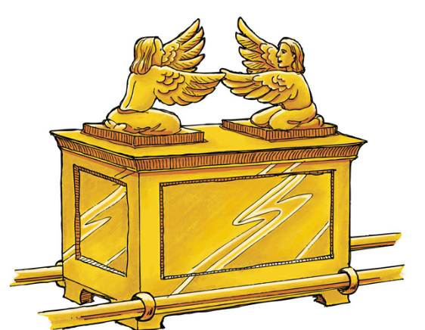
Bible Study – Class 3
The Old Testament: Torah (Pentateuch)- Exodus (7) – The Ark

Slide 22
Bible Study – Class 3
The Old Testament: Torah (Pentateuch)
Leviticus
The book of laws concerning morals, cleanliness, food, etc. It teaches access to God through sacrifices.
The way of access to God
Through sacrifices and offerings
a. They burnt offerings signifying atonement and consecration 1:2-9
b. Grain offerings signifying Thanksgiving 2:1-2
c. Sin she offerings for Priests - signifying reconciliation chapter 4
d. Trespass offerings signifying cleansing from guilt 6:2-7
e. Fellowship offerings 7:11-15
2. Through priestly meditation
The human priesthood the call 8:1-5, the cleansing of 8:6, garments of 8:7-13, atonement for 8:14-34

Slide 23
Bible Study – Class 3
The Old Testament: Torah (Pentateuch)
Leviticus (2)
Special laws governing Israel
As to food Chapter 11
As to cleanliness sanctification customs morals etc., all emphasizing purity of life as a condition of divine favor chapters 12-20
Purity of priests and offerings chapter 21-22
The five annual feasts
The feast of the Passover beginning April 14th 23:5 commemorating the exodus
The feast of Pentecost or weeks the 6th day of June commemorating the giving of the laws 23:15
The feast of trumpets the first day of October 23:23-25
The day of atonement the 10th day of October the high priest enters the holy of holy's to make atonement for the sins of the people chapter 16 and chapter 23:26-32
The feast of tabernacles beginning the 15th day of October commemorating the life in the wilderness and Thanksgiving for the harvest chapter 23:39-43

Slide 24
Bible Study – Class 3
The Old Testament: Torah (Pentateuch)
Leviticus (3)
General laws and instructions on the sabbatical year
In seventh year the ground was left untilled chapter 25:2-7
The year of jubilee; once in 50 years slaves were liberated debtors were freed and general restitution took place chapter 25:8-16
Conditions of blessing and warnings concerning chastisement chapter 26
The love vows chapter 27

Slide 25
Bible Study – Class 3
The Old Testament: Torah (Pentateuch)
Leviticus
Three defining moments; find the defining moments and send them to your instructor.

Slide 26
Bible Study – Class 3
End of Class 3

